Slide 1
DSA 2 Project:
Image Compression and Manipulation using Quadtrees
Vardhan Mundada 112103091
Rukmini Nazre 112103098
Omkar Oak 112103099
Notes:
Entered text
The Quadtree Image Compression project aims to provide an efficient compression technique for images using the quadtree data structure. This project contains
Image Compression
Image Rotation(Horizantal & Vertical Flip)
Applying Filters(Red, Blue, Green, Black-White & Grayscale)
Image format :- PPM (Portable Pixmap Format)
Run Locally
gcc -Wall main.c Quadtree.c menu.c -o main
./main input.ppm output.ppm
Clone the project
git clone https://github.com/omkaroak26/DSA2-project.git
PPM Image format
A PPM file consists of two parts, a header and the image data header has 3 parts:
Line 1: The first "line" is a magic PPM identifier, it can be "P3" or "P6"
Line 2: width and height separated by space
Line 3: maximum value of the color components for the pixels (which will be 255)
P6
1024 512
255
Image format:
If it is "P3" then the image is given as ascii text, the numerical value of each pixel ranges from 0 to the maximum value given in the header.
The lines should not be longer than 70 characters.
If the PPM magic identifier is "P6" then the image data is stored in byte format, one byte per colour component (R,G,B).
Process of image compression:
Input the images in PPM(Portable Pixmap Format) format.
Read Image Metadata: Read the height and width of the image from the PPM file.
Create a blank matrix of size height x width to hold the image data
Read PPM File and input it into the matrix
Compression: It includes two sub-steps: uniformity calculation and quadtree creation.
5.1. Uniformity Calculation: Call the uniformity function, which calculates the average of variances within the image.
5.2. Create Quadtree: The function creates a quadtree data structure that represents the image.
Compress Quadtree: Compress the quadtree structure. Compress Quadtree until threshold is less than mean value from uniformity.
Convert Compressed Quadtree to Matrix: Convert the compressed quadtree back into a matrix representation.
This step involves decompressing the quadtree structure and reconstructing the matrix.

Slide 2
PPM Image Format
A PPM file consists of two parts, a header and the image data header has 3 parts:
Line 1: The first "line" is a magic PPM identifier, it can be "P3" or "P6"
Line 2: width and height separated by space
Line 3: maximum value of the color components for the pixels (which will be 255)
#Example
P6
1024 512
255
Image format:
If it is "P3" then the image is given as ascii text, the numerical value of each pixel ranges from 0 to the maximum value given in the header. The lines should not be longer than 70 characters.
If the PPM magic identifier is "P6" then the image data is stored in byte format,
one byte per colour component (R,G,B).

Slide 3
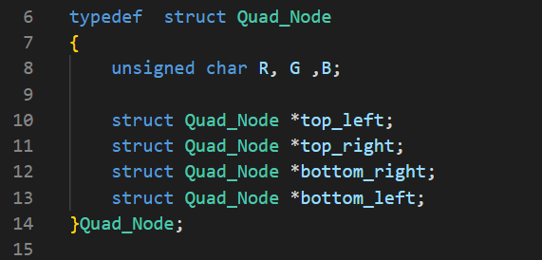
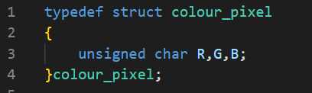
QuadTree Data Structure
A QuadTree is a tree data structure in which each internal node has exactly four children.
Quadtrees are used to partition a two-dimensional space by recursively subdividing it into four quadrants or regions.
We store the RGB values of each pixel in a single Node
So, the typedef for the Node of a QuadTree would be:
Typedef for colour pixel

Slide 4

Process of Image Compression:
1. Input the images in PPM(Portable Pixmap Format) format.
2. Read Image Metadata:
Read the height and width of the image from the PPM file.
3. Create a blank matrix of size height x width to hold the image data
4. Read PPM File and input it into the matrix
5. Compression:
It includes two sub-steps: uniformity calculation and quadtree creation.
5.1. Uniformity Calculation:
Call the uniformity function, which calculates the average of variances within the image.

Slide 5
Process of Image Compression:
5.2. Create Quadtree:
The function creates a quadtree data structure that represents the image.
6. Compress Quadtree:
Compress the quadtree structure. Compress Quadtree until threshold is less than mean value from uniformity.
7. Convert Compressed Quadtree to Matrix:
Convert the compressed quadtree back into a matrix representation. This step involves decompressing the quadtree structure and reconstructing the matrix.
8. Matrix to PPM:
Convert the matrix data back into PPM format.

Slide 6

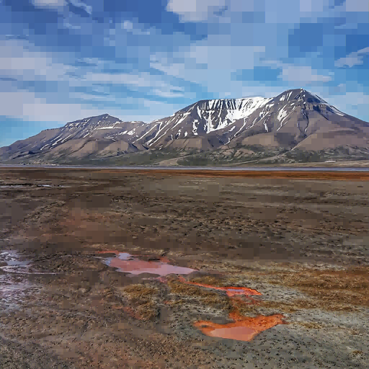
Compression Example
Image size: 481 kb
Threshold: 100
Image size: 291 kb

Slide 7
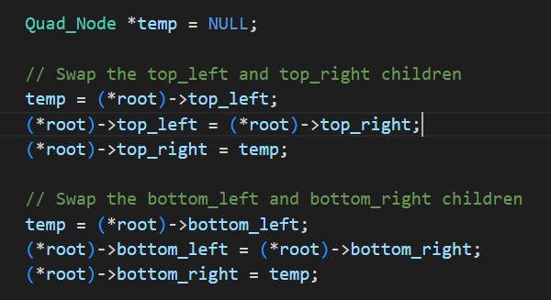
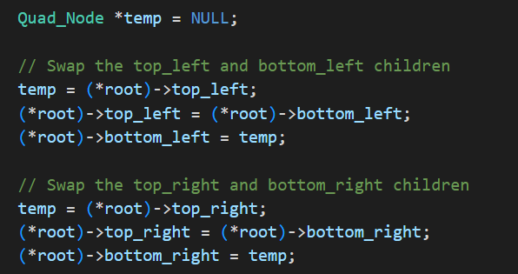
Changing Image Orientation
Each parent node or pixel has 4 child nodes. Thus, the image can be flipped by swapping nodes and calling the main flip function recursively for each child node.
Horizontal Flip: Top left and bottom left are swapped with top right and bottom right respectively.
Vertical Flip: Top left and top right are swapped with bottom left and bottom right respectively.
Horizontal Flip
Vertical Flip

Slide 8
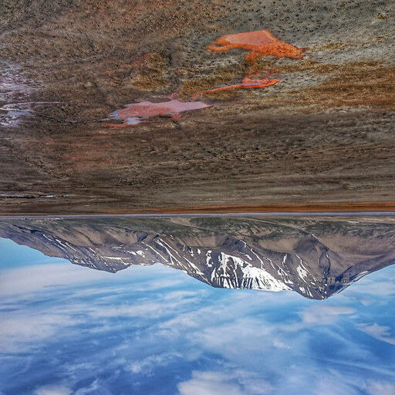

Rotation Example
Vertical
Horizontal

Slide 9
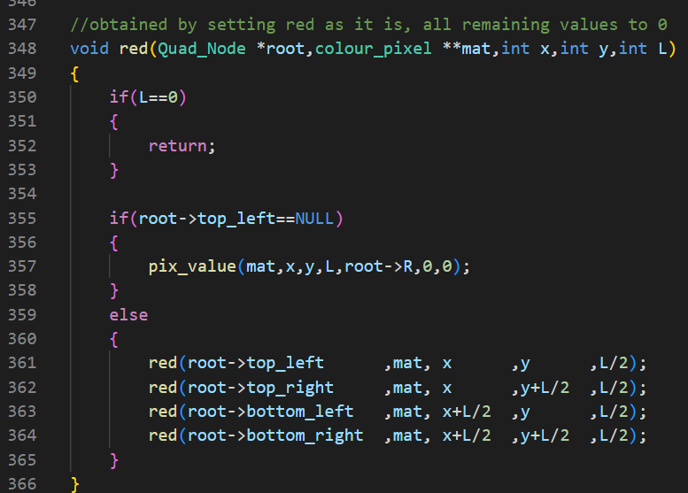
Applying Filters on Images
During the application of a red filter to an image, the code recursively calls the function until it reaches a terminal node. At this node, only the red colour value is preserved, while the green and blue values are set to zero (root->red,0, 0).
This process selectively retains the red colour information, effectively filtering out the green and blue colours.
Similar approach is carried for application of Blue, Green filter and Black-White images.

Slide 10
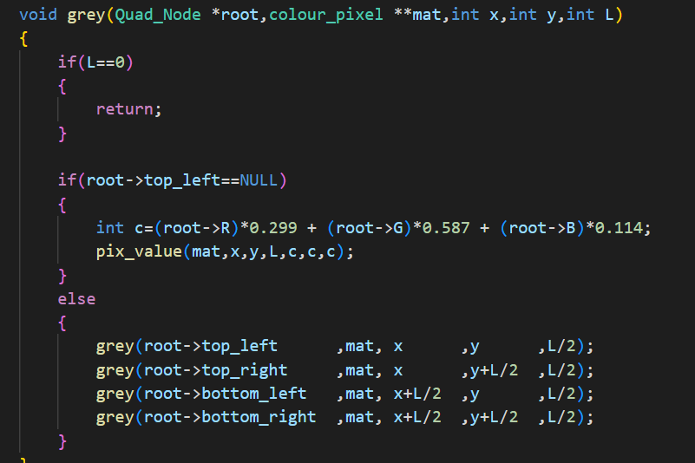

Applying Grayscale
Function grey converts an image into grayscale using the formula:
R * 0.299 + G * 0.587 + B * 0.114
This function recursively traverses and converts the image into grayscale by calculating the appropriate grayscale value for each pixel based on the RGB values.

Slide 11
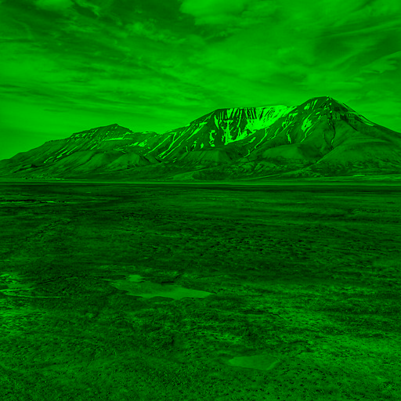
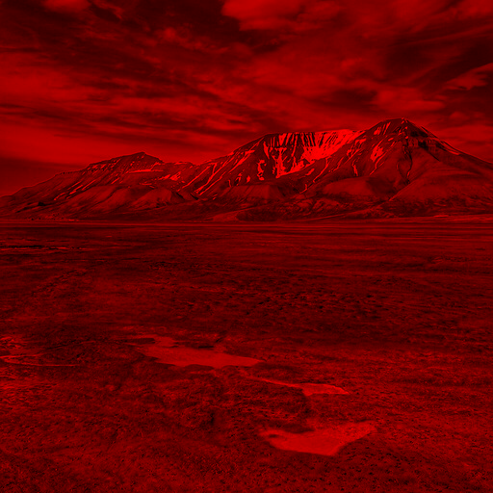
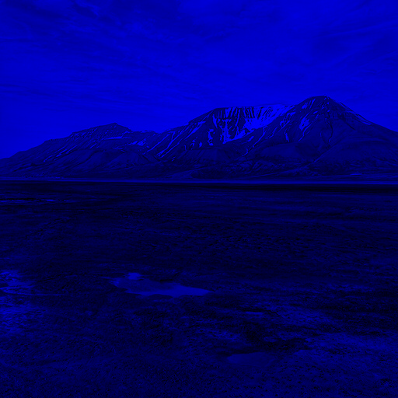
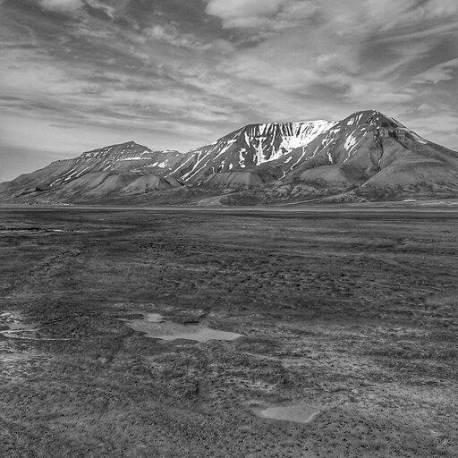
Colour Filter Example

Slide 12
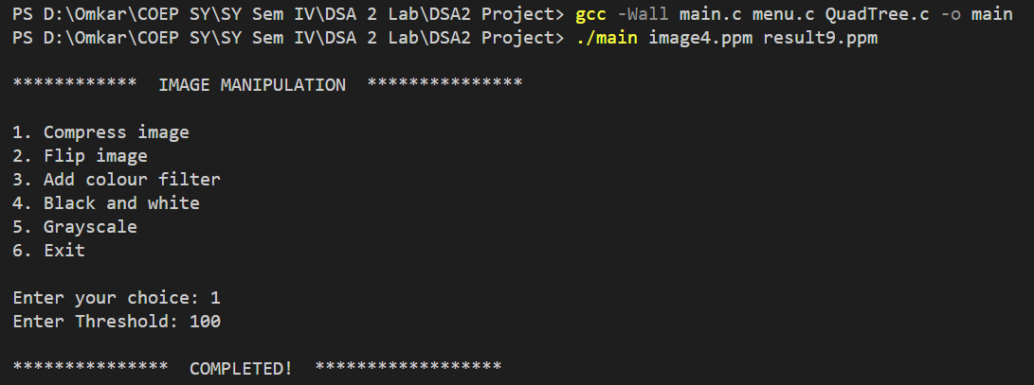
To run the code :
Command line format: ./main <input.ppm> <output.ppm>

Slide 13
References:
Naderi, Ramin, "Quadtree-based processing of digital images" (1986). Dissertations and Theses, Portland University Paper 3590.
"Quadtree structures for image compression applications” by Tassos Markast and John Reif , Duke University, Durham
Quadtrees and Image Processing, CS-106 Harvard University
https://medium.com/@tannerwyork/quadtrees-for-image-processing-302536c95c00

Slide 14
THANK YOU
Vardhan Mundada 112103091
Rukmini Nazre 112103098
Omkar Oak 112103099

